Slide 1
Mobile-Commerce Development
Lesson
Overview of mobile commerce
Lecturer:
Tran Duy Thanh, Phd
Nguyen Quang Phuc, Msc
Email: thanhtd@uel.edu.vn
Blog: https://tranduythanh.com
Phone: 0987773061

Slide 2
Lesson Objective
-Students know the trends of M-Commerce
-Know the key features of M-Commerce, such as: Widespreadness, Accessibilty, Personalized, Convenient, etc.
-Know the Applications of M-Commerce and thinking about idea for final project
-Know the attentions when implementing mobile commerce
-Explained why we choose Android
-Install Android Studio and create a sample mobile Project

Slide 3
Outlines
Introduction M-Commerce
Features of M-Commerce
Applications of M-Commerce
Implementing mobile commerce attentions
Development Mobile Applications, why Android?
Discussions

Slide 4

Introduction M-Commerce
Mobile commerce or M-commerce refers to activities of buying and selling goods online, paying bills via mobile devices such as phones, tablets, etc.
Mobile commerce helps businesses get closer to customers online. It also brings convenience to customers with many product options, payment methods, and delivery methods from different brands and sellers.

Slide 5
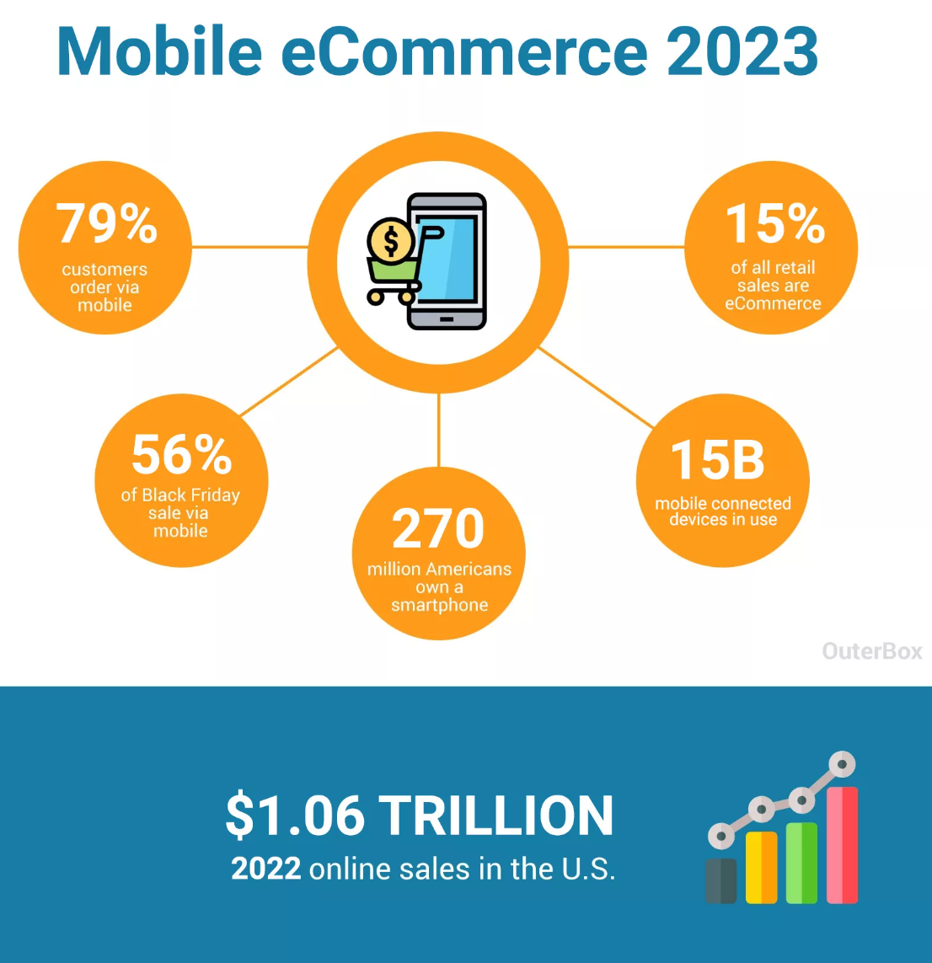
Introduction M-Commerce
84% of American households own a smart phone
Over 270 million U.S. consumers own smartphones
At least 79% of smartphone users have made a purchase online using their mobile device in the last 6 months
It’s estimated over 50% of all eCommerce purchases during the 2022 holiday season were made on a smartphone
eCommerce dollars now comprise 15% of ALL retail revenue
80% of shoppers used a mobile phone inside of a physical store to either look up product reviews, compare prices or find alternative store locations
An estimated 15 billion mobile connected devices are currently in use
Source: https://www.outerboxdesign.com/web-design-articles/mobile-ecommerce-statistics

Slide 6
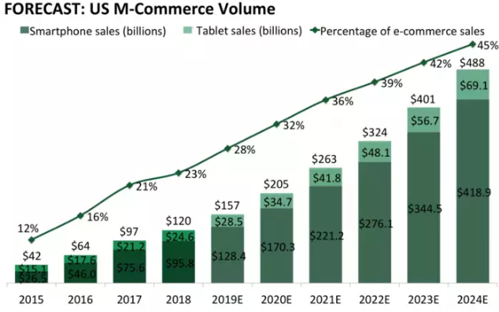
Introduction M-Commerce
Revenue from mobile commerce in the US market

Slide 7
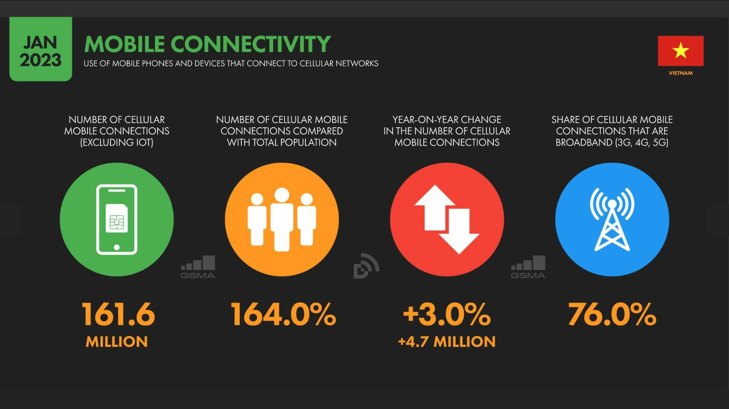
Introduction M-Commerce
Statistics on mobile connectivity in Vietnam
Source: https://www.vnetwork.vn/news/internet-viet-nam-2023-so-lieu-moi-nhat-va-xu-huong-phat-trien/

Slide 8
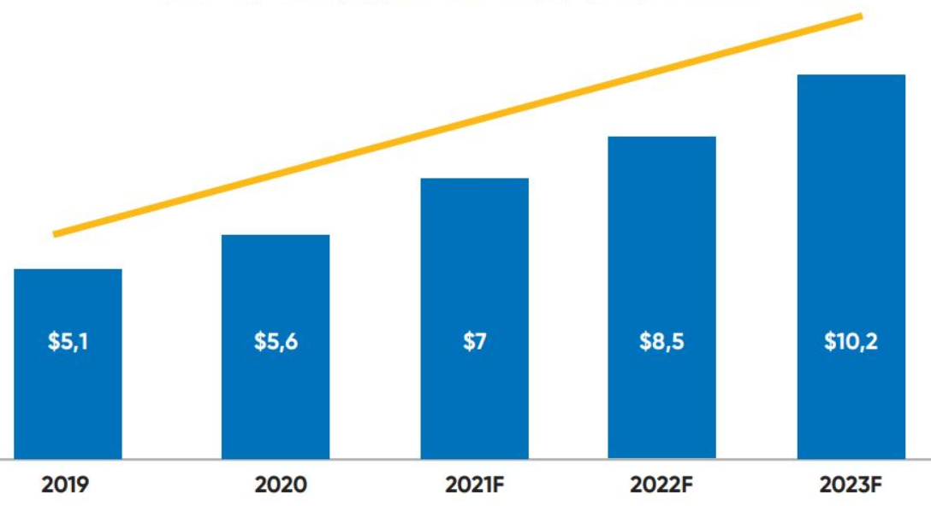
Introduction M-Commerce
Scale of mobile e-commerce in Vietnam (2019-2023)
In the past few years, mobile commerce (M-Commerce) has changed dramatically in the Vietnamese market. The following figures demonstrate the explosion of mobile commerce.
Source: JP. Morgan

Slide 9
Features of M-Commerce
Widespreadness
Accessibility
Personalized
Convenient
Customization
Determine customer location
Telephony interaction

Slide 10

Features of M-Commerce
Widespreadness
The coverage of Mobile Commerce is unquestionable. M-commerce allows users to easily find information, exchange, and shop via mobile devices with Internet connection no matter where they are. This helps save time and effort for users.

Slide 11

Features of M-Commerce
Accessibility
Nowadays, the proportion of smart mobile device users is increasing. Therefore, the customer base participating in mobile commerce is getting larger and larger, bringing great opportunities for businesses.

Slide 12
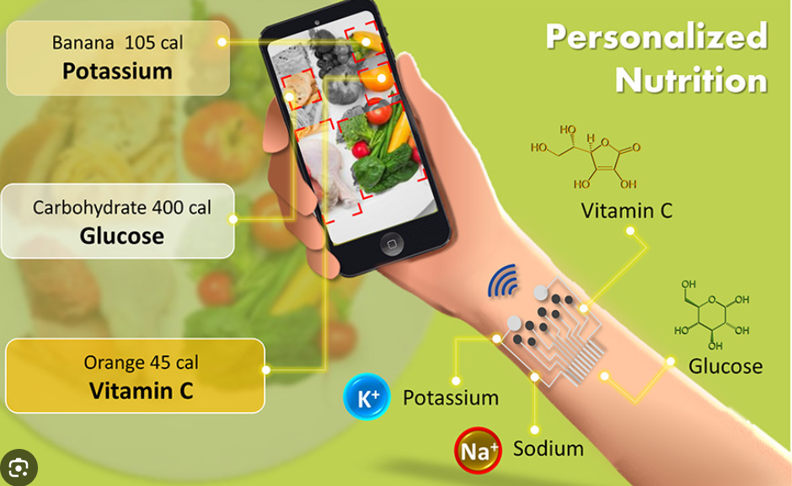
Features of M-Commerce
Personalized
With basic information when registering for mobile commerce services, manufacturers can provide personalized experiences for users, creating maximum convenience for customers.

Slide 13
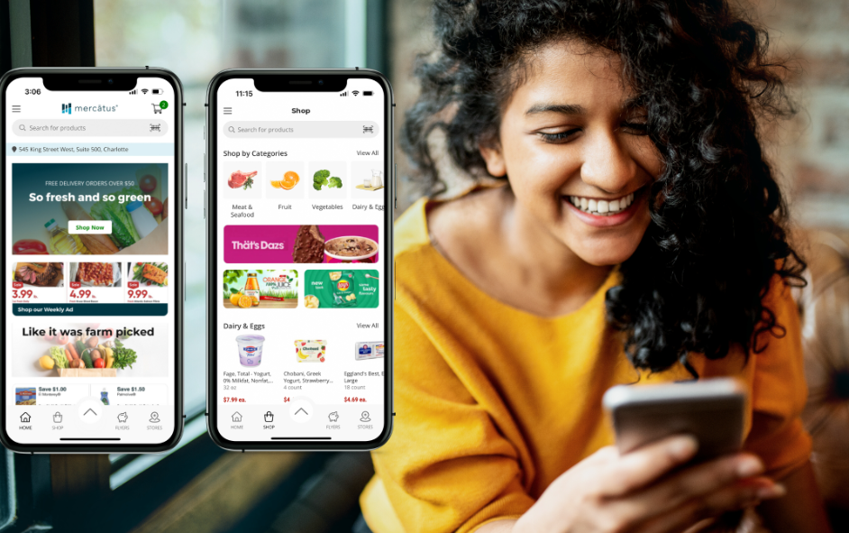

Features of M-Commerce
Convenient
With just a phone in hand, customers can immediately participate in mobile commerce activities, anywhere at any time.

Slide 14

Features of M-Commerce
Customization
We can easily customize the functions on the mobile application to send appropriate notifications to customers, as well as help manage information better.

Slide 15

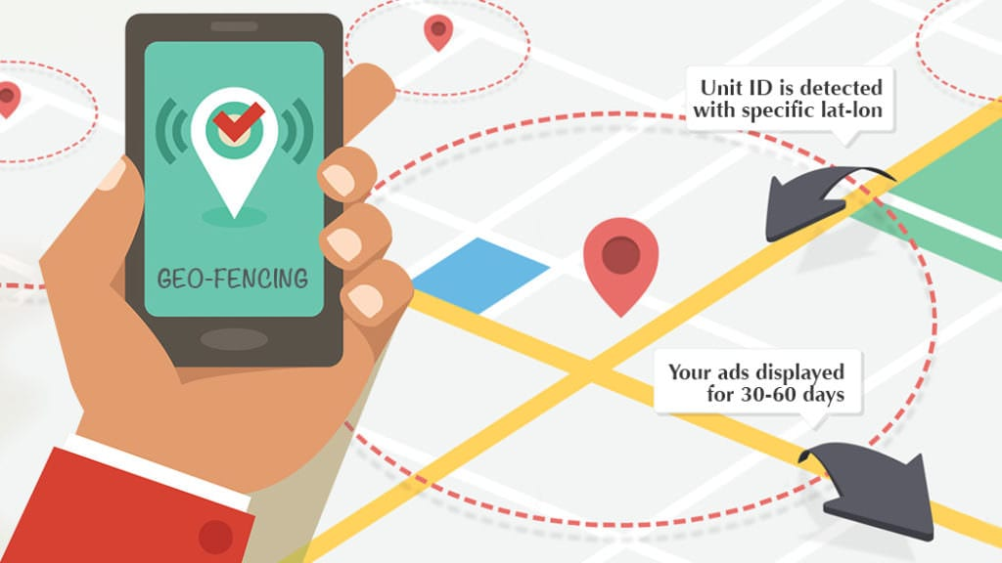
Features of M-Commerce
Determine customer location
This feature shows where users are physically at any given time, which is key to delivering relevant products and services.

Slide 16

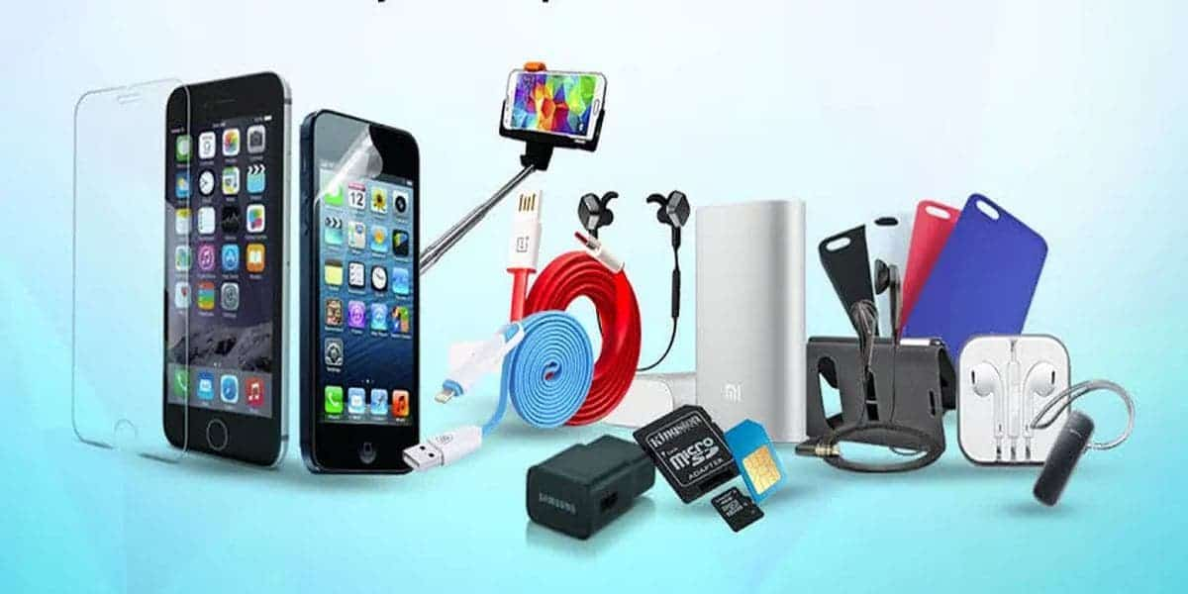
Features of M-Commerce
Telephony interaction
For mobile, especially Android, we can easily develop mobile commerce software that integrates Telephony features.

Slide 17
Applications of M-Commerce
▷ M-Commerce for Finance
▷ Retail and After sale Services
▷ Mobile Marketing
▷ Mobile Ticketing
▷ Mobile Entertainment
▷ Hotel Reservations
▷ Healthcare and Medicine
▷ Intra-Office Communication
▷ M-Commerce for Information
▷ M-Commerce for Gaming
…

Slide 18
Implementing mobile commerce attentions
Methods to increase mobile commerce
Video and marketing in mobile commerce
Websites and applications
Multi-platforms

Slide 19
Implementing mobile commerce attentions
Methods to increase mobile commerce:
Mobile commerce takes place through websites or mobile applications, so fast page/app loading speed is one of the deciding factors in customer experience. In addition, operations and processes must be designed to be simple and suitable for all customers so that users can use it most conveniently.

Slide 20
Implementing mobile commerce attentions
Video and marketing in mobile commerce:
Mobile commerce activities are the leading trend today, so businesses need to focus on promoting marketing and advertising activities to attract more new customers to use the services.

Slide 21
Implementing mobile commerce attentions
Websites and applications:
Businesses should combine the purchase journey on websites and applications flexibly. Normally, consumers often research products through Google and go to the business's website. So applications need to start from the website and then lead to another application to compare more or place an order.

Slide 22
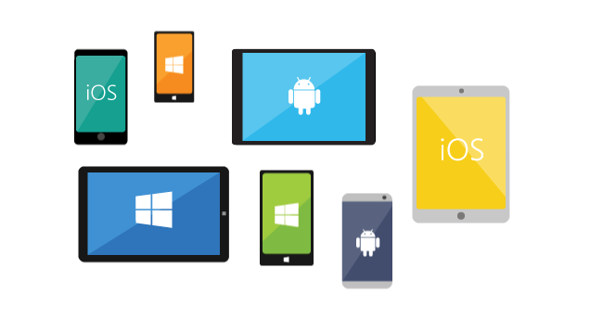
Implementing mobile commerce attentions
Multi-platforms:
Mobile applications can run on different operating systems, or for each operating system we must have corresponding applications.

Slide 23


Development Mobile Applications, why Android?
Android: Java + Kotlin
Ios: Objective C+ Swift

Slide 24
Development Mobile Applications, why Android?
Why Android?
The Android system gives you a lot of flexibility, allowing you to customize your device interface and is simple to use. You can choose from a variety of themes, icons, fonts, keyboards, and more to personalise your Android so it looks exactly how you want. Some Android devices, including Samsung phones and tablets, even allow you to change the navigation settings so you can use your device to make the experience your own.

Slide 25

Development Mobile Applications, why Android?
Why Android?
Enjoy double the standard refresh rate
The high refresh rate provides noticeably smoother transitions, animations, and scrolling.

Slide 26
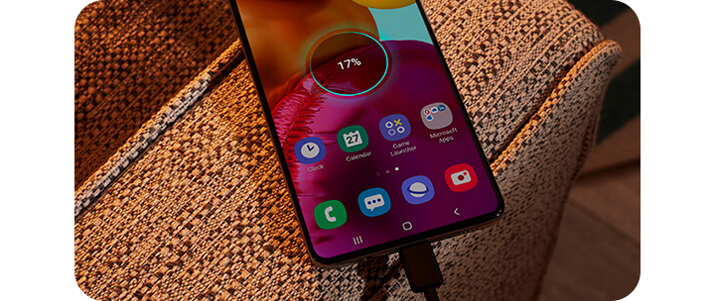
Development Mobile Applications, why Android?
Why Android?
Organize your files using the folder system
It’s never been easier to transfer data or charge in a flash. USB type-C gives you faster data transfer speeds than previous USB types. It also allows for increased charging capability, enabling Fast Charging

Slide 27
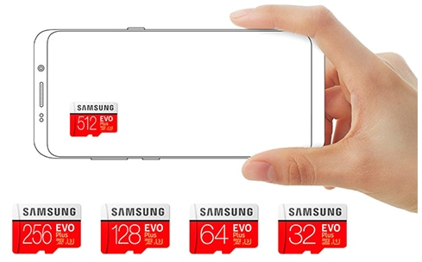
Development Mobile Applications, why Android?
Why Android?
Memory expansion
Running out of space for files? No need to delete your beloved photos, videos, and apps. Many Android smartphones come with the option to expand your memory using a microSD card.

Slide 28
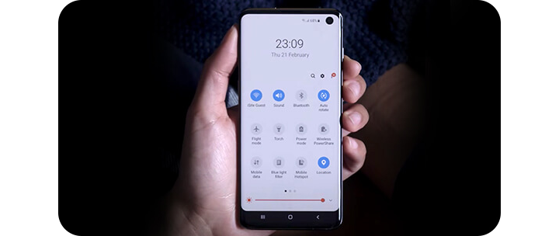
Development Mobile Applications, why Android?
Why Android?
Easy settings
The Android notification bar makes it easy to find and change settings on the fly. Swipe down and you can press & hold any icon to access its settings, including WiFi, Bluetooth, brightness and more.

Slide 29
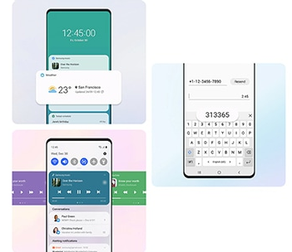
Development Mobile Applications, why Android?
Why Android?
Access app info from your homepage with Widgets
The Android notification bar makes it easy to find and change settings on the fly. Swipe down and you can press & hold any icon to access its settings, including WiFi, Bluetooth, brightness and more.

Slide 30
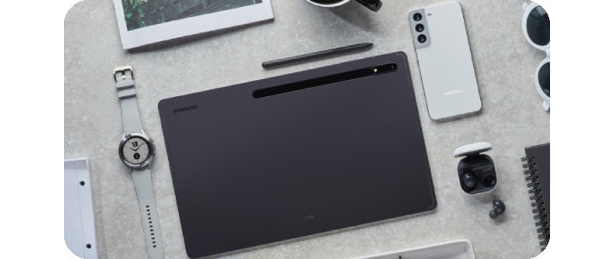
Development Mobile Applications, why Android?
Why Android?
Sync your devices with the Samsung Galaxy ecosystem
Connect your Samsung devices with the Samsung ecosystem to control apps and notifications across multiple devices.

Slide 31
Development Mobile Applications, why Android?
Why development applications on Android?
It is an Open Source Technology
Huge Device Market Share
Easier Entry to Market
Enormous Market Share of Apps
Numerous & Variety of Job Opportunities to Choose from
Freedom & freelancer Job
Easy to Learn
Numerous Online Courses
Requires minimal computer resources

Slide 32
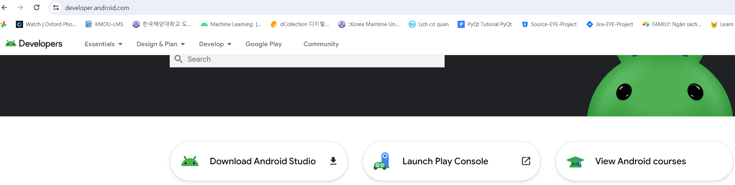
Development Mobile Applications, why Android?
https://developer.android.com/

Slide 33
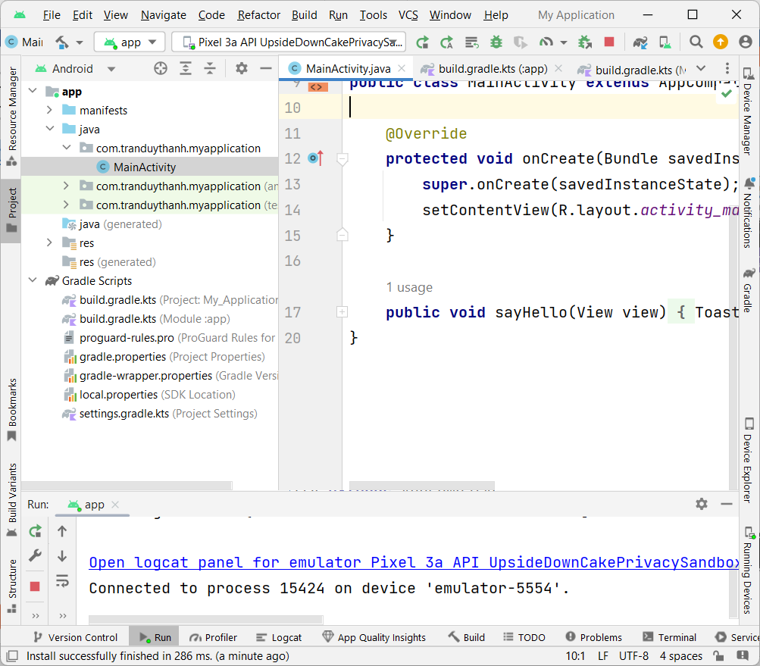
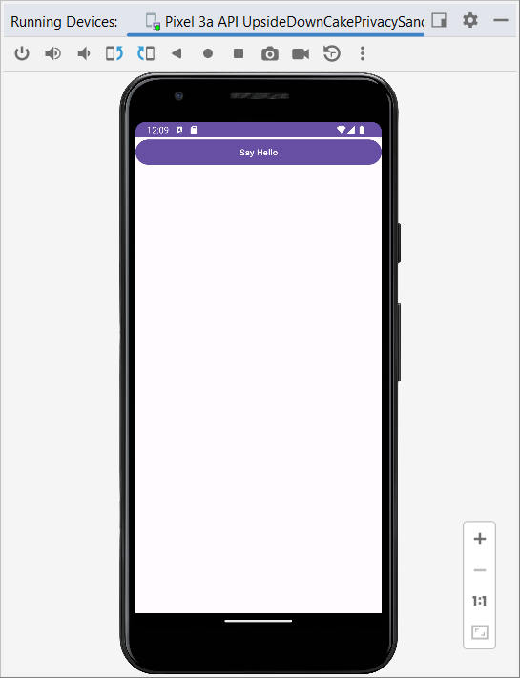
Development Mobile Applications, why Android?

Slide 34
Discussions
Q1: What are the difference between E-commerce and M-Commerce?
Q2: What are the growth potentials of mobile commerce in Vietnam?
Q3: The ways to increase mobile commerce sales?
Q4: Discussion about user experiences on Mobile and Desktop. Please give advice when developing the same application but running on both Mobile and Desktop.
Q5: What is Mobile Payment? What are the popular types of Mobile Payment?
Q6: What are the main functions that need to be designed in a mobile commerce application (Food service)?

Slide 35
Next Lesson
Android OS and Android Studio Tool
Overview of the Android OS
Android application programming environment
Android Studio tools
Execute Android application

Slide 36
THANK YOU!

